Slide 1

Electricity Demand Forecasting using Deep Learning Techniques
Rushiil Deshmukh, Neha Dipali, Safiuddin Mohammed, Preety Pinghal, Shivarjun Sarkar

Slide 2
Intro
Reducing transmission and storage costs to optimize substation distribution
Benefits
Operating and maintenance costs
Improved Power System and Fault Analysis
Better decisions for future development
Forecasting the electricity demand using different deep learning techniques and comparing their accuracy

Slide 3
Data
Data Source: Electric Reliability Council of Texas (ERCOT)
Granularity: Hourly level.
Training Set - 2017 and 2018
Testing Set – 2019 data
Objective: Forecast the overall ERCOT value at daily and weekly aggregations.

Slide 4
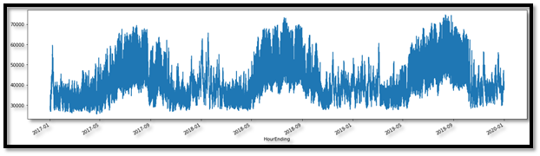
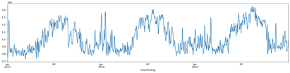
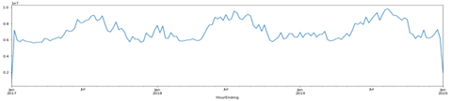
Data Analysis
Seasonality in the data
Demand consistently higher in the summer and winter months
Slight decline in demand during the fall and spring

Slide 5
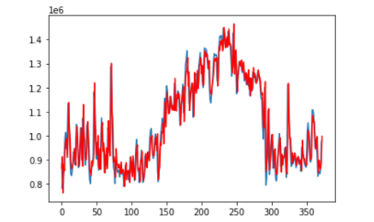
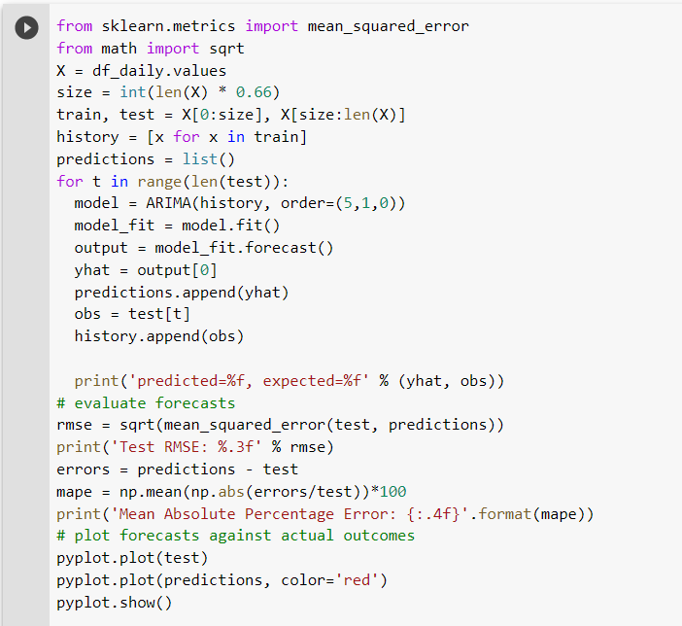
ARIMA
Autoregressive Integrated Moving Average (ARIMA): Generalization of the simpler Autoregressive Moving Average and adds the notion of integration.
The MAPE error for this model, for the daily data came out to be 4.97%

Slide 6
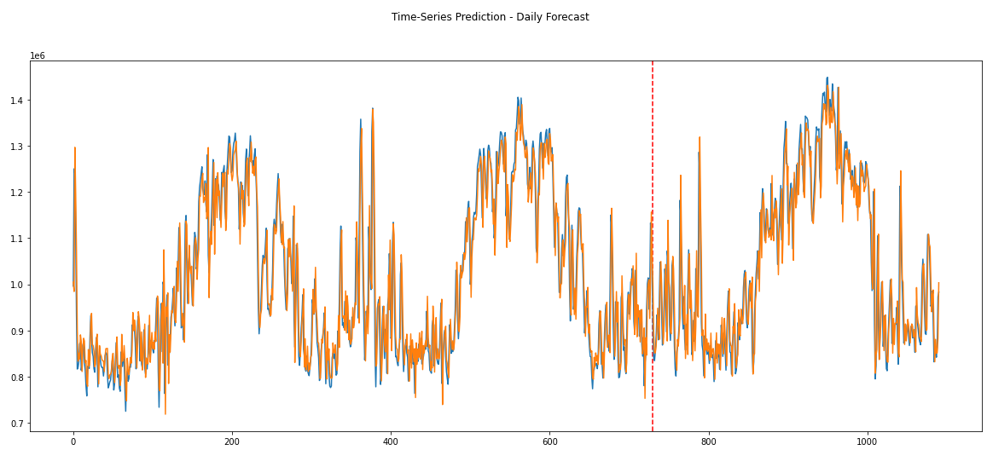
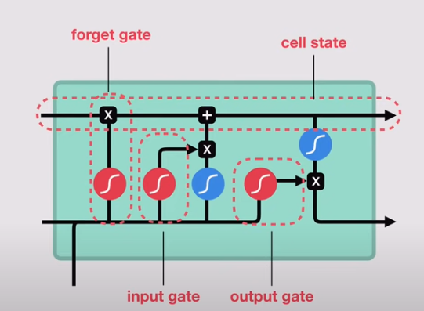
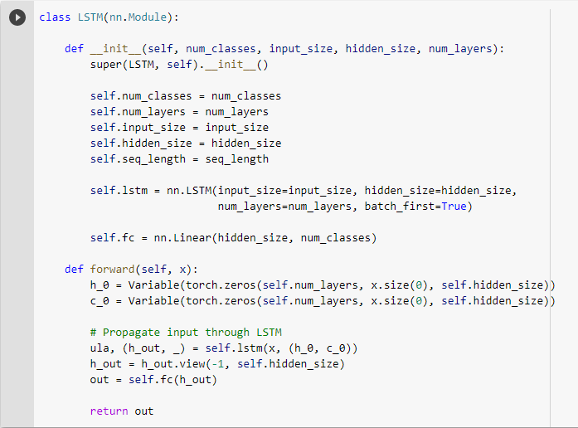
LSTM
Vanilla LSTM - Daily:
Mean Absolute Percentage Error: 4.1337

Slide 7
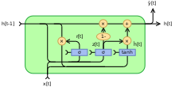
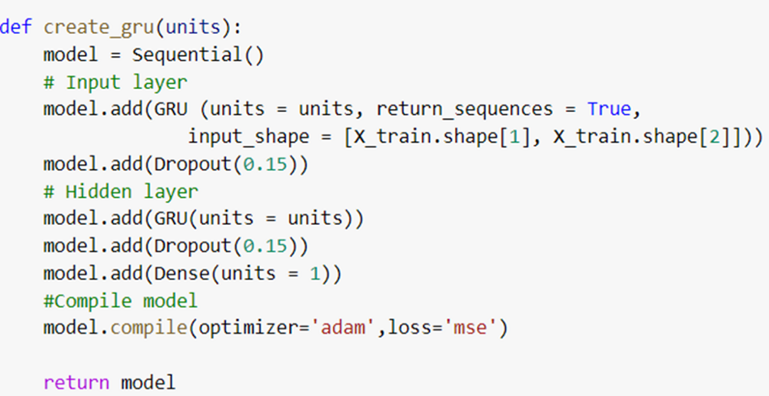
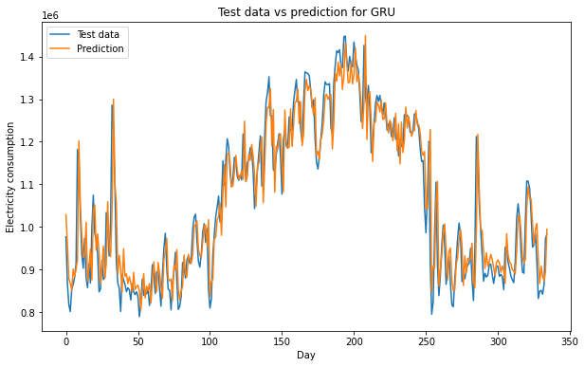
GRU
Refinement of the LSTM Model​
Model retains information over time using “Update” and “Reset” gates​
“Memory-Centered” type of Neural Network​
MAPE – 4.12%
Notes:
A Gated Recurrent Unit, or GRU, is a type of recurrent neural network. It is similar to an LSTM, but only has two gates - a reset gate and an update gate - and notably lacks an output gate. Fewer parameters means GRUs are generally easier/faster to train than their LSTM counterparts.

Slide 8
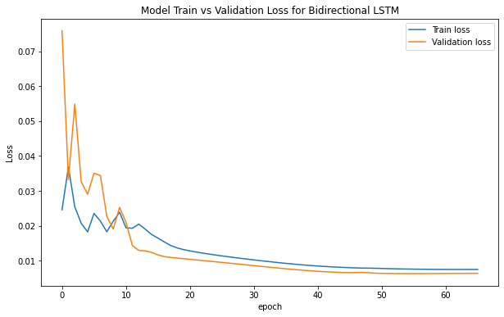
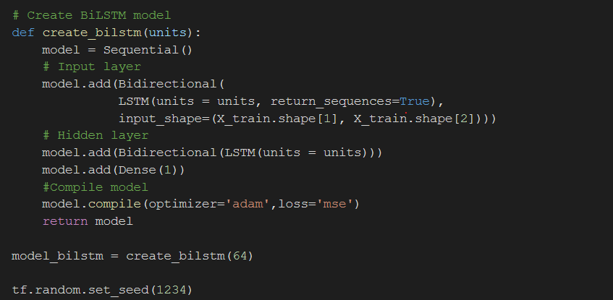
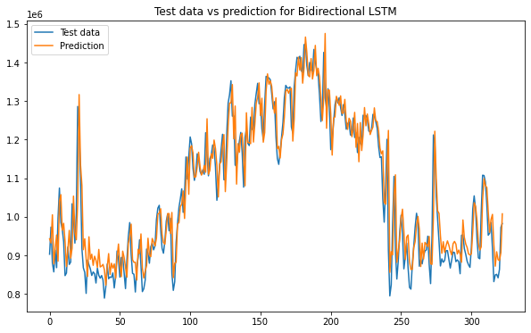
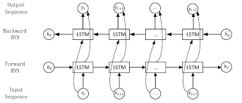
BI - LSTM
Training two separate LSTM models with forward and backward data pass, then merging the two using functions such as concatenation
MAPE = 4.15%

Slide 9
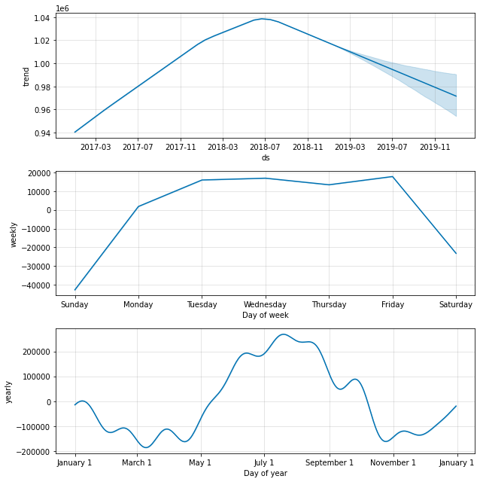
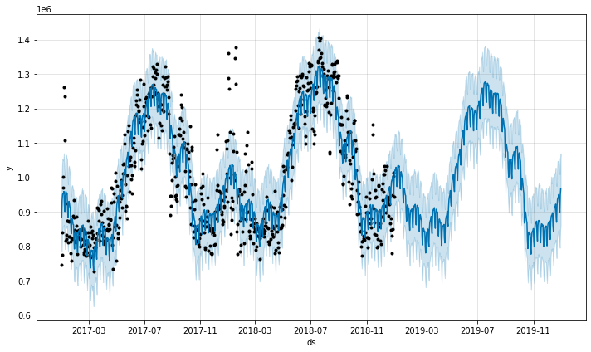
Facebook Prophet
Prophet(Meta) is a procedure for forecasting time series data based on an additive model where non-linear trends are fit with yearly, weekly, and daily seasonality, plus holiday effects.

Slide 10
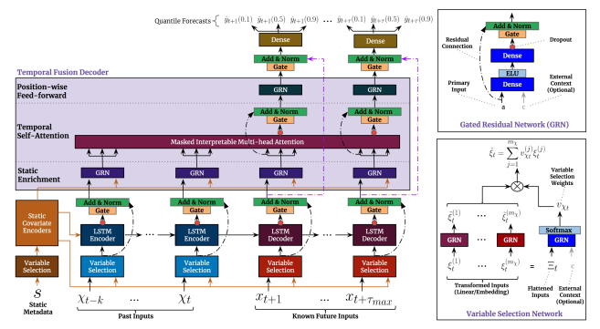
Temporal Fusion Transformer
A novel attention-based architecture that combines high-performance multi-horizon forecasting with interpretable insights into temporal dynamics. To learn temporal relationships at different scales, TFT uses recurrent layers for local processing and interpretable self-attention layers for long-term dependencies.
The major constituents of TFT are:
Gating mechanisms
Variable selection
Static covariate
Temporal processing
Prediction intervals via quantile forecasts

Slide 11
Results
Model | MAPE
ARIMA | 4.97%
LSTM | 4.13%
GRU | 4.12%
BI-LSTM | 4.15%
PROPHET | 6.1%
TFT | 9.3%

Slide 12
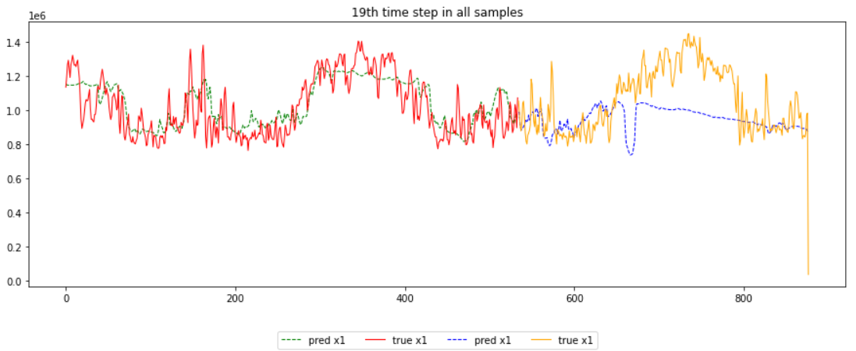
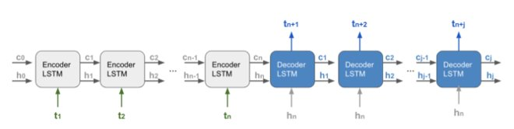
Further Attempted Models
1. CNN LSTM – Adding a 1D or 2D convolutional layer before an LSTM for improved pattern matching
2. Encoder-Decoder Seq2seq LSTM Architecture

